Slide 1

RUNGTA COLLEGE OF DENTAL SCIENCES & RESEARCH
TITLE OF THE TOPIC: ENDO – PERIO LESION
DEPARTMENT OF CONSERVATIVE DENTISTRY AND ENDODONTICS

Slide 2
Specific learning Objectives
At the end of this presentation the learner is expected to know ;
Core areas* | Domain ** | Category #
Contributing factors | COGNITIVE | MUST NOW
Charcot lyden crystals | PSYCHOMOTOR | NICE TO KNOW
Inadequate endodontic treatment | AFFECTIVE | DESIRE TO KNOW

Slide 3
CONTENTS
INTRODUCTION
FUNGI
VIRUSES
NON LIVING
Pathogens
Contributing factors

Slide 4
INTRODUCTION
The association of the degenerative changes in the pulp tissues and periodontal disease presents a clinical and conceptual dilemma ever since it was first described in the beginning of the twentieth century by Cahn (1927).
Simring and Goldberg in 1964 - pulpal and periodontal problems are responsible for more than 50% of tooth mortality.
Weine (1972) - endodontics is actually “periapical periodontics.”

Slide 5
The periodontium and the dental pulp are closely associated, sharing embryonic, functional, and anatomical interrelationships.
Ectomesenchymal cells proliferate to form the dental papilla and follicle, which are the precursors of the pulp and the periodontium respectively.
This embryonic development gives rise to anatomical connections, some of which remain patent throughout life.

Slide 6
Root canal space infection is the main etiology of apical periodontitis .The advance of the disease involves inflammatory reaction of the peri-radicular tissues and periodontal ligamental space .
Periodontal disease, on the other hand, involves marginal periodontium and results in the progressive loss of the supportive tissues.

Slide 7
FUNGI
Candida albicans -Main
Fungi may also colonize canal walls and invade dentinal tubules.
Other species such as Candida glabrata, Candida guillermondii, Candida incospicia, and Rodotorula mucilaginosa have also been detected.
Waltimo TM, Siren EK, Torkko HL, et al. Fungi in therapy resistant apical periodontitis. Int Endod J. 1997;30:96–101.

Slide 8
Predisposing factors
Immunocompromising diseases such as cancer
Certain intracanal medicaments
Local and systemic antibiotics
Previous unsuccessful endodontic therapy

Slide 9
Reduction of specific strains of bacteria in the root canal during endodontic treatment may allow fungal overgrowth in the remaining low nutrient environment.
Poor asepsis during endodontic treatment or post-preparation procedures.
Presence of fungi in root canals is directly associated with their presence in saliva.
Egan MW, Spratt DA, Ng YL, et al. Prevalence of yeasts in saliva and root canals of teeth associated with apical periodontitis. Int Endod J.2002;35:321–329.28.

Slide 10
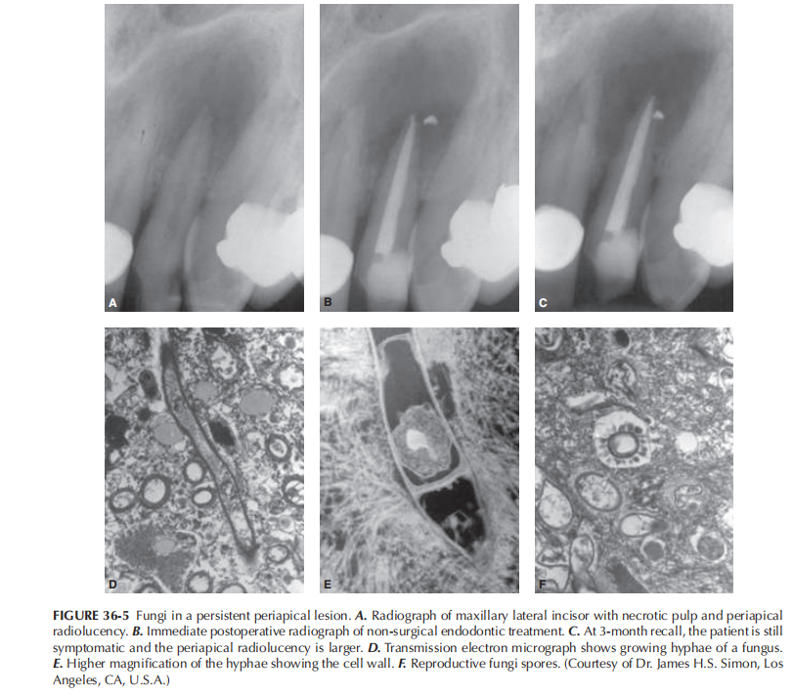

Slide 11
VIRUSES
In Periodontal disease - herpes simplex virus was frequently detected in gingival crevicular fluid and in gingival biopsies of periodontal lesions.
Human cytomegalovirus -65% of periodontal pocket samples and in about 85% gingival tissue samples.
Viruses involved in pulpal disease and associated periapical pathoses -human cytomegalovirus and Epstein–Barr virus.
Sabeti M, Simon JH, Nowzari H, Slots J. Cytomegalovirus and Epstein-Barr virus active infection in periapical lesions of teeth with intact crowns. J Endod. 2003;29:321–323.

Slide 12
Gingival herpesviruses were found to be associated with increased occurrence of subgingival Porphyromonas gingivalis, Bacteroides forsythus, Prevotella intermedia, Prevotella nigrescens, T. denticola, and Actinobacillus actinomyce-temcomitans.
Contreras A, Umeda M, Chen C, et al. Relationship between herpesviruses and adult periodontitis and perioodontopathic teria. J Periodontol. 1999;70:478–48

Slide 13
The presence of viruses in the dental pulp was first reported in a patient with AIDS.
DNA of HIV virus was also detected in periradicular lesions.
Glick M, Trope M, Pliskin ME. Detection of HIV in the dental pulp of a patient with AIDS. J Am Dent Assoc 1989: 119: 649–650.

Slide 14
Active virus infection may give rise to production of an array of cytokines and chemokines with the potential to induce immunosuppression and tissue destruction.
Herpes virus activation in periapical inflammatory cells may impair the host defense and give rise to overgrowth of bacteria as seen in periodontal lesions
Frequent reactivation of periapical herpes virus may support rapid periodontal breakdown

Slide 15
NON LIVING PATHOGENS
Non-living pathogens can be either extrinsic such as foreign bodies or intrinsic including a variety of tissue components.

Slide 16
FOREIGN BODIES
Presence of certain foreign substances in situ may explain the emergence or persistence of some apical pathose.
Substances such as dentin and cementum chip , amalgam, root canal filling materials, cellulose fibers from absorbent paper points, gingivalretraction cords, leguminous foods,and calculus-like deposits.
clinical reaction -either acute or chronic.
Symptomatic or Asymptomatic.

Slide 17
Microscopically -multinucleated giant cells surrounding the foreign material in a chronic inflammatory infiltrate.
Treatment of choice - Mechanical or surgical removal of the foreign bodies.

Slide 18
EPITHELIAL REST OF MALASSEZ
Normal constituents of both the lateral and apical periodontal ligament.
If the rests remain, they may respond to the stimuli and proliferate in an attempt to wall off the irritants coming through the apical foramen.
The epithelium can be surrounded by chronic inflammation.
This lesion istermed epitheliated granuloma and if not treated, the epithelium will continue to proliferate in an attempt to wall off the source of irritation communicating from the apical foramen.

Slide 19
CHOLESTROL CRYSTALS
Histopathological finding.
cholesterol clefts in periapical disease - 18% to 44% .
Formed from cholesterol released by either disintegrating erythrocytes of stagnant blood vessels within the periapical lesion , lymphocytes, plasma cells, and macrophages that die in great numbers and disintegrate in chronic periapical lesions or by the circulating plasma lipids.

Slide 20
Induce foreign body reaction.
Accumulation of cholesterol crystals in inflamed periapical tissues -cause failure of endodontic therapy.
Nair PNR. Cholesterol as an aetiological agent in endodontic failures- a review. Aust Endod J 1999: 25:19–26.

Slide 21
RUSSEL BODIES
Small, spherical accumulations of an eosinophilic substance found within or near plasma cells and other lymphoid cells.
Present in 80% of periradicular lesions.
Synthesis of excessive amounts of normal secretory protein in certain plasma cells engaged in active synthesis of immunoglobulines.

Slide 22
RUSHTON HYALINE BODIES
Feature unique to some odontogenic cysts.
Frequency varies from 2.6% to 9.5% .
Appear either within the epithelial lining or the cyst lumen.
Linear (straight or curved),irregular, rounded, and polycyclic structures, or they may appear granular.

Slide 23
keratinous in nature ,of hematogenous origin, a specialized secretory product of odontogenic epithelium , or degenerated red blood cells.

Slide 24
CHARCOL LAYDEN CRYSTALS
Naturally occurring hexagonal bi pyramidal crystals derived from the intracellular granules of eosinophils and basophils.
Associated with increased numbers of peripheral blood or tissue eosinophils in parasitic, allergic, neoplastic, and inflammatory diseases.
Activated macrophages -important role in the formation of Charcot–layden crystals.

Slide 25
It can be detected within a periapical lesion that failed to resolve after conventional endodontic treatment .

Slide 26
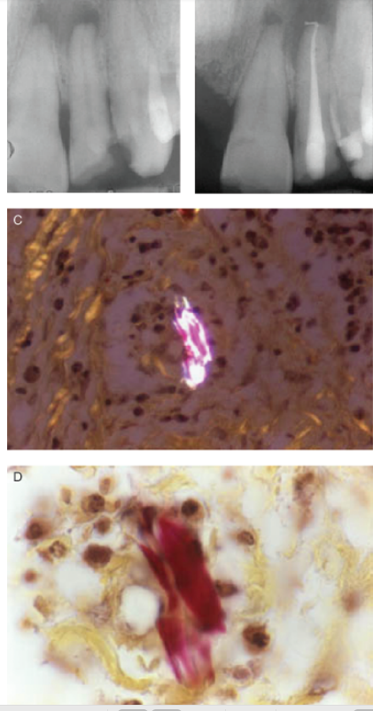
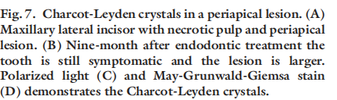

Slide 27
CONTRIBUTING FACTORS
Inadequate endodontic treatment
Coronal leakage
Traumatic injuries
Resorptions
Root perforation
Developmental malformations

Slide 28
INADEQUATE ENDODONTIC TREATMENT
It is essential to clean, shape, and obturate the canal system well in order to enhance successful outcomes.
Poor endodontic treatment often results in treatment failure.
Endodontic failures can be treated either by orthograde retreatment or by endodontic surgery with good success rates.
Ray HA, Trope M. Periapical status of endodontically treated teeth in relation to the technical quality of the rooal quality of the root filling and the coronal restoration. Int Endod J. 1995;28:12–18.

Slide 29
TAKE HOME MESSAGE
Because of its history, the complex amalgam restorations may be the most frequently placed complex restoration.
However due to the increasing benefits of composites, the many types of auxiliary retention forms available, and the variations of tooth preparations required for complex restorations, the operator should be familiar with all of these techniques, if he or she is to use these restorations on a regular basis.

Slide 30
QUESTIONS
What are charcot lyden crystals
What does inadequate root canal treatment do in endo perio lesion

Slide 31
REFERENCES:
1. Sturdevant's Art and Science of Operative Dentistry - fourth Edition
2. Operative Dentistry - Modern theory and practice - First Edition- M.A. Marzouk
3. Text book of operative dentistry - Vimal K. Sikri
4.Fundamentals of Operative Dentistry- Summit JB- 2nd edition
5.Text book of operative dentistry → nisha carg,amit carg
6.Principles and Practice of Operative Dentistry-Gerald T. Charbeneau-Third edition.
7.Clinical operative dentistry-principles and practice→ramya Raghu,Raghu sreenivasan

Slide 32
THANK YOU

